Slide 1

Problem Solving Using Computer
Course Code: BCAC 0018
Lecture - 2
Course: BCA I Year I Semester
By: Mr. Sanjiv Agrawal
Sanjiv.agrawal@gla.ac.in
+91-8923015116

Slide 2
What is Computer?
The term computer is derived from the word compute.
The word compute means to calculate.
A computer is an electronic machine that accepts data from the user, processes the data by performing calculations and operations on it, and generates the desired output results.
Computer performs both simple and complex operations, with speed and accuracy.

Slide 3
Data & Information
Data : Data is a raw material of information. Unorganized facts which itself has no meaning.
Information : Proper collection of the data is called information. Processed data is called information

Slide 4
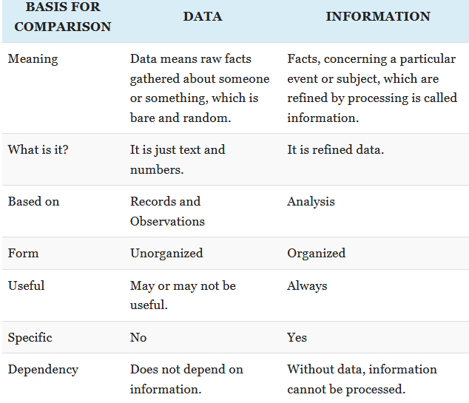

Slide 5

The Input-Process-Output Concept
A computer is an electronic device that→
accepts data,
processes data,
generates output, and
stores data.
Referred to as input-process-output concept.

Slide 6
Input
The computer accepts input data from the user via an input device like keyboard.
The input data can be characters, word, text, sound, images, document, etc.
Process
The computer processes the input data. For this, it performs some actions on the data by using the instructions or program given by the user of the data.
The action could be an arithmetic or logic calculation, editing, modifying a document, etc.
During processing, the data, instructions and the output are stored temporarily in the computer’s main memory.

Slide 7
Storage
Output
The output is the result generated after the processing of data. The output may be in the form of text, sound, image, document, etc.
The computer may display the output on a monitor, send output to the printer for printing, play the output, etc.
The input data, instructions and output are stored permanently in the secondary storage devices like disk or tape.
The stored data can be retrieved later, whenever needed

Slide 8
Characteristics of Computer
SPEED : In general, no human being can compete to solving the complex computation, faster than computer.
ACCURACY : Since Computer is programmed, so what ever input we give it gives result with accurately.
STORAGE : Computer can store mass storage of data with appropriate format.
DILIGENCE : Computer can work for hours without any break and creating error.
VERSATILITY : We can use computer to perform completely different type of work at the same time.
NO IQ : Computer does not work without instruction.
NO FEELING : Computer does not have emotions, knowledge, experience, feeling.

Slide 9
Uses of Computer
Computers are an integral part of our lives.
Wherever we are—sitting in our homes, working in the office, driving on roads, sitting in a movie hall, staying in a hotel, etc.—our lives are directly or indirectly affected by the computers.
In this era of information, we are dependent on the storage, flow and processing of data and information, which can only be possible with the help of computers.

Slide 10
Applications of Computer
Education:
Computers are extensively used, as a tool and as an aid, for providing education.
Educators use computers to prepare notes and presentations of their lectures.
Computers are used to develop computer-based training packages, to provide distance education using the e-learning software, and to conduct online examinations.
Government :
The government uses computers to manage its own operations and also for e-governance.
The websites of the different government departments provide information to the users.
Computers are used for the filing of income tax return, paying taxes, online submission of water and electricity bills, for the access of land record details, etc.
The police department uses computers to search for criminals using fingerprint matching, etc.

Slide 11
Sports:
A computer can be used to watch a game, view the scores, improve the game, play games (like chess, etc.) and create games.
They are also used for the purposes of training players.
Advertising:
Computer is a powerful advertising media.
Advertisement can be displayed on different websites, electronic-mails can be sent and reviews of a product by different customers can be posted.
Computers are also used to create an advertisement using the visual and the sound effects. Web advertising has become an important factor in the marketing plans of almost all companies.

Slide 12
Medicine:
Medical researchers and practitioners use computers to get information about the development in medical research or to take opinion of doctors globally.
The medical history of patients is stored in the computers.
Computers are also an integral part of various kinds of sophisticated medical equipments like ultrasound machine, X-ray scan machine, MRI scan machine, etc.
Science and Engineering:
Scientists and engineers use computers for performing complex scientific calculations, for designing and making drawings (CAD/CAM applications).
Complex scientific applications like the launch of the rockets, space exploration, etc., are not possible without the computers.

Slide 13
Home:
At home, people use computers to play games, to maintain the home accounts, for communicating with friends and relatives via Internet, for paying bills, for education and learning, etc.
Microprocessors are embedded in house hold utilities like, washing machines, TVs, food processors, home theatres, security devices, etc.

